Slide 1
COMS E6998: Microservices and Cloud Applications Lecture 7: Class Evaluation, OAuth2/FB/Twitter, AWS Security, 12 Factor Apps, Step Functions
Dr. Donald F. Ferguson
dff9@columbia.edu

Slide 2
Contents

Slide 3
Contents
Questions, Comments, Discussion?
Midterm class evaluations
Project 4: OAuth2 and security
OAuth2
Facebook walkthrough with code.
OAuth2 flow.
Twitter example and code.
Infrastructure and application security model (as an example)
Resources and operations.
Identities, roles, groups.
Customer GW Authorizer.
12 Factor Applications
Workflow/Orchestration and Step Functions
Overview
Simple examples

Slide 4
Midterm Class Evaluations

Slide 5
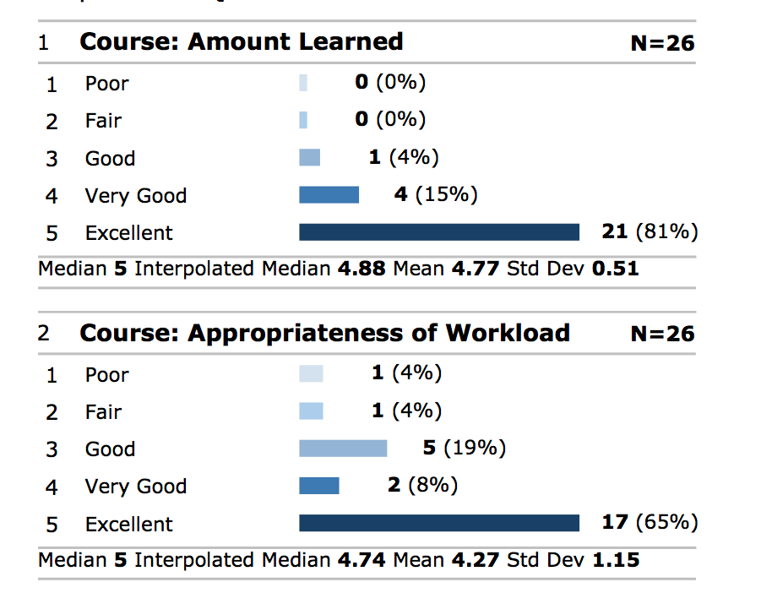
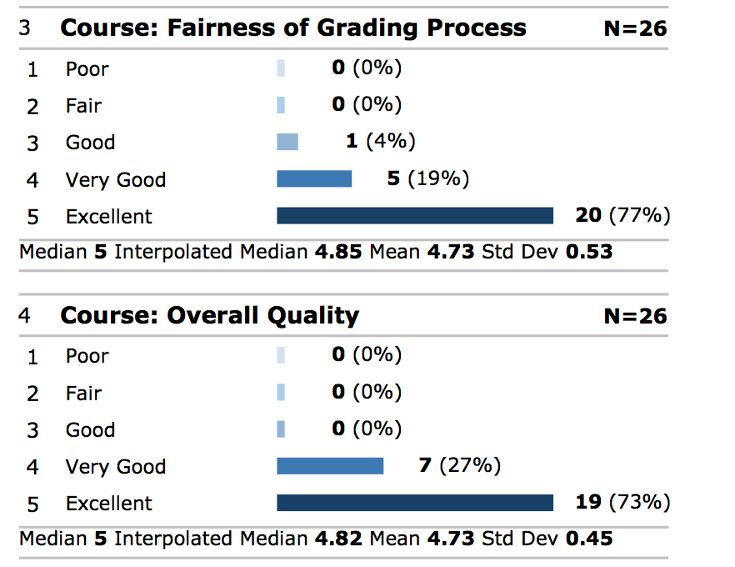
Summary – Course

Slide 6
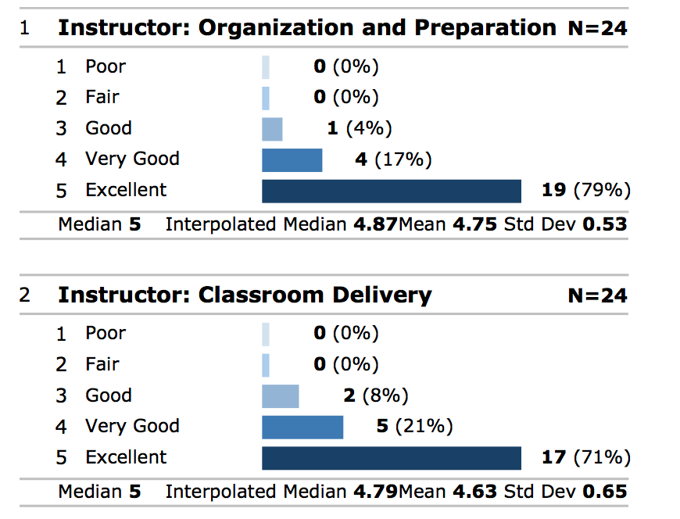
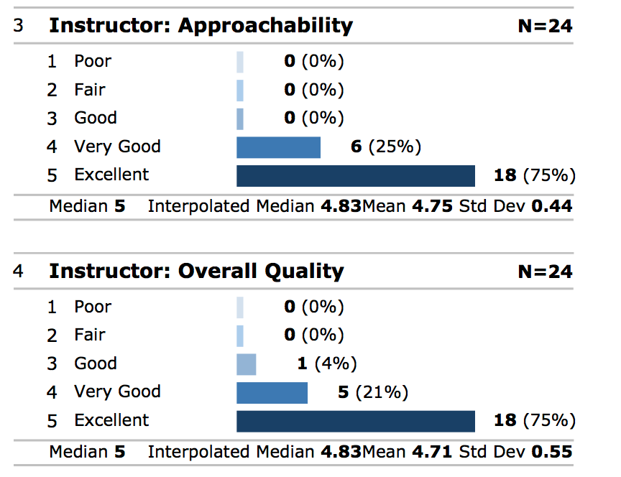
Summary – Instructor

Slide 7
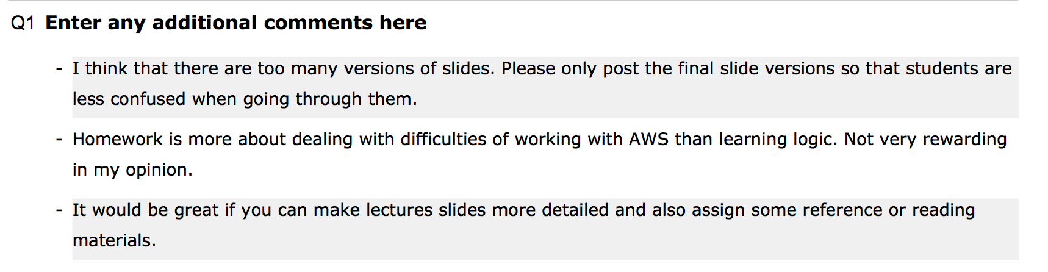
Comments
Note: Did not include two positive comments.
Actions
I will try to be more disciplined about the versions of slides.
I will also try to identify references and reading.
AWS complexity and nuisance factor is trickier
Imagine what it would be like if we were using several clouds.
I will try to provide templates to help you get started and more examples.

Slide 8
Project 4

Slide 9
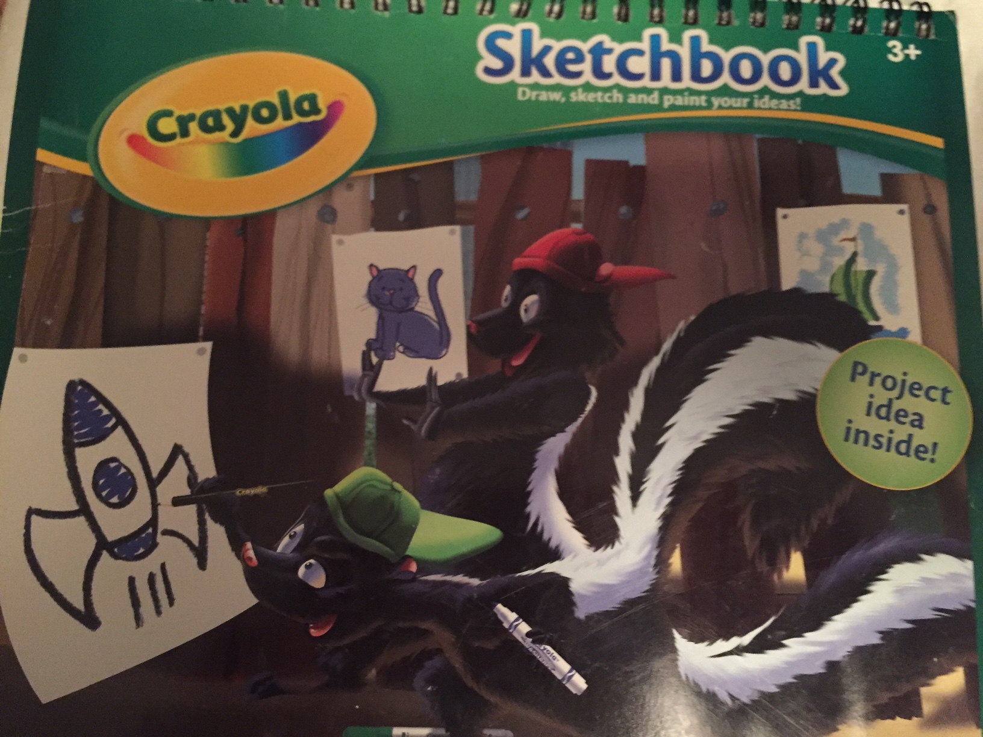
My Mousepad when Preparing Proj. 4 Spec.
Project
Idea
Inside

Slide 10
Reminder – (Some) Security Facets
Authentication: “ (…) is the act of confirming the truth of an attribute of a single piece of data claimed true by an entity. In contrast with identification, which refers to the act of stating or otherwise indicating a claim purportedly attesting to a person or thing's identity, authentication is the process of actually confirming that identity. ”
Authorization:
“The process of authorization is distinct from that of authentication. Whereas authentication is the process of verifying that ‘you are who you say you are’, authorization is the process of verifying that ‘you are permitted to do what you are trying to do’.
“Authorization is the function of specifying access rights/privileges to resources related to information security and computer security in general and to access control in particular ^{[1]}. More formally, "to authorize" is to define an access policy.”
(Communication) Security
“Transport Layer Security (TLS) and its predecessor, Secure Sockets Layer (SSL), both frequently referred to as "SSL", are cryptographic protocols that provide communications security over a computer network.”
“The connection is private (or secure) because symmetric cryptography is used to encrypt the data transmitted.”
The identity of the communicating parties can be authenticated using public-key cryptography.
The connection ensures integrity because each message transmitted includes a message integrity check using a message authentication code to prevent undetected loss or alteration of the data during transmission.
HTTPS (also called HTTP over Transport Layer Security [TLS],^{[1]} HTTP over SSL,^{[2]} and HTTP Secure^{[3][4]}) is a communications protocol for secure communication over a computer network which is widely used on the Internet. HTTPS consists of communication over Hypertext Transfer Protocol (HTTP) within a connection encrypted by Transport Layer Security, or its predecessor, Secure Sockets Layer. The main motivation for HTTPS is authentication of the visited website and protection of the privacy and integrity of the exchanged data.

Slide 11
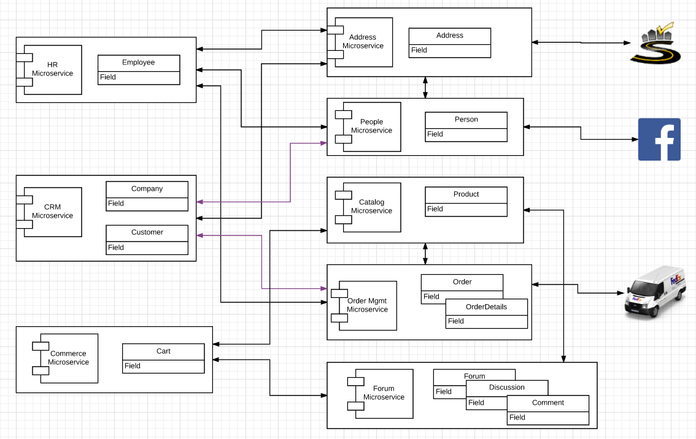
Project 4 – Start/Expand Commerce Microservice
Use Lambda function
Customers may
Register with
And subsequently logon with
Facebook or Twitter
Just
Implement register/logon
We will later
Use Step Functions for composing microservices and APIs
Publish commerce actions to FB and Twitter.
Also, write
A placeholder
API Gateway Custom Authorizer
Which we will later use to manager authorization to orders.

Slide 12
Seeka TV Demo Email, FB, Twitter OAuth2

Slide 13
Demo

Slide 14
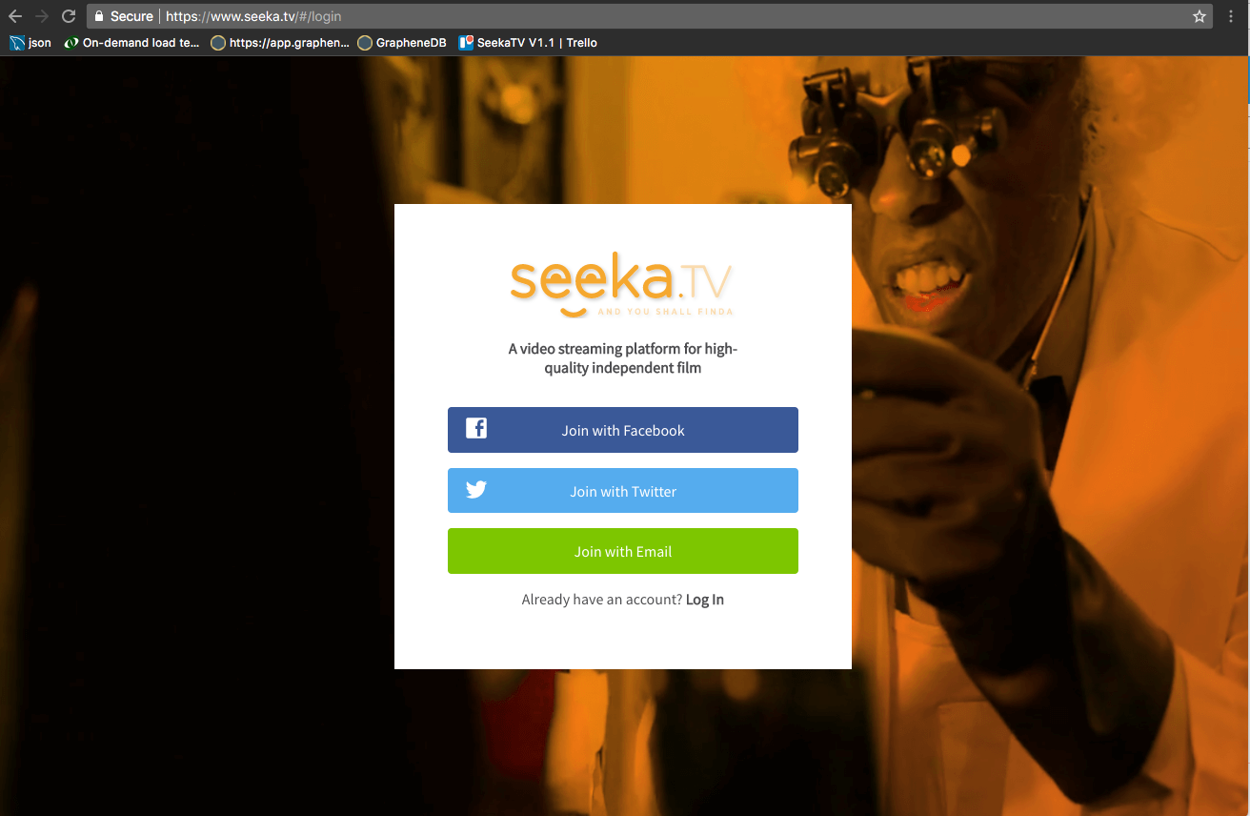
Registration

Slide 15
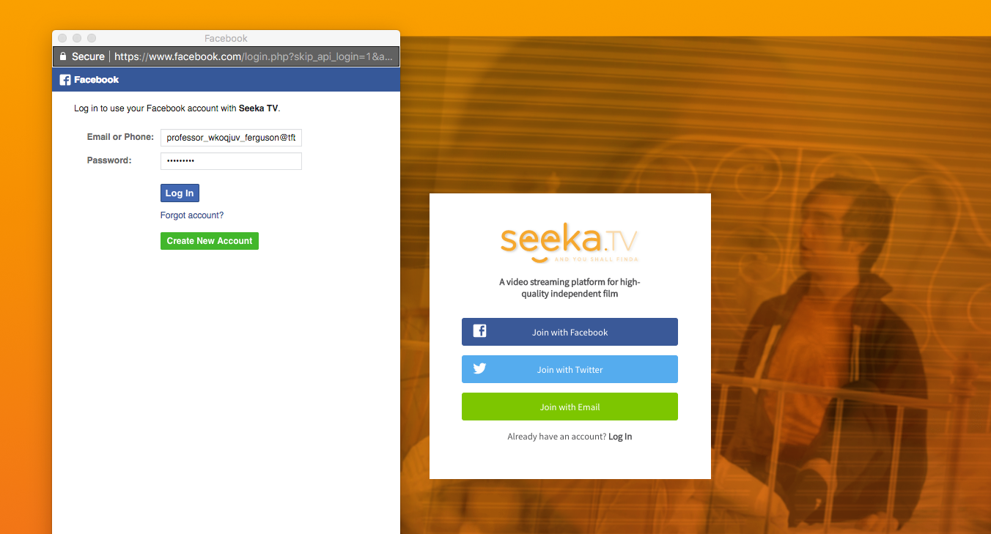
Registration

Slide 16
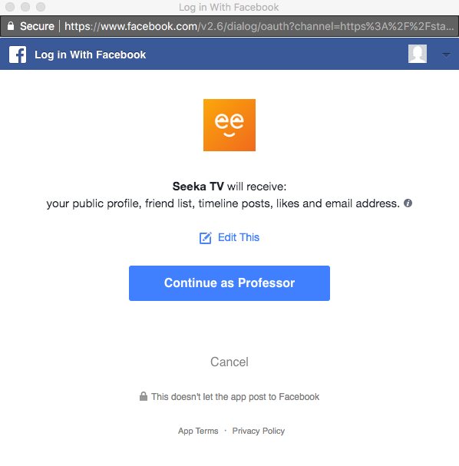
Registration

Slide 17
Pros and Cons of Social Media Logon (https://econsultancy.com/blog/61911-the-pros-and-cons-of-a-facebook-login-on-ecommerce-sites)
Pros
One password for many services: Some people hate making up passwords
Familiarity: People trust Facebook and may not want to give you info.
Added convenience drives business: “Forced registration is a major cause of checkout abandonment, with a quarter (26%) of respondents in a recent Econsultancy survey stating that being forced to register would cause them to abandon a purchase.”
Sharing: Simplifies customers sharing their use of your site → drives awareness.
Access to profile data: Do not require users to enter a new profile.
Your site does not have to have code for password reset, locked account, etc.
Cons
Some users don’t want everything to be connected.
Some people don’t use Facebook.
Muddying your brand image.

Slide 18
Social Media Registration (Facebook)

Slide 19
Frontend

Slide 20
Facebook
Validate Token/Get Info
Register(Token)
OK
Save Data

Slide 21
Facebook
Simple, quick, easy.
Primarily for browser JavaScript calling API
But also works for server side
Although not strictly OAuth2
And probably frowned upon.
Validate Token/Get Info
Register(Token)
OK
Save Data

Slide 22
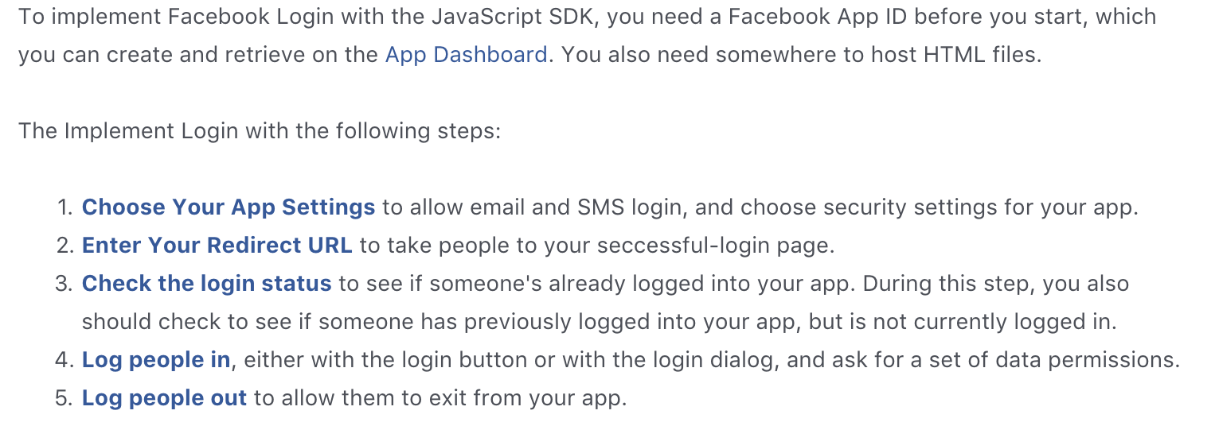
Facebook Login (https://developers.facebook.com/docs/facebook-login/web/)

Slide 23
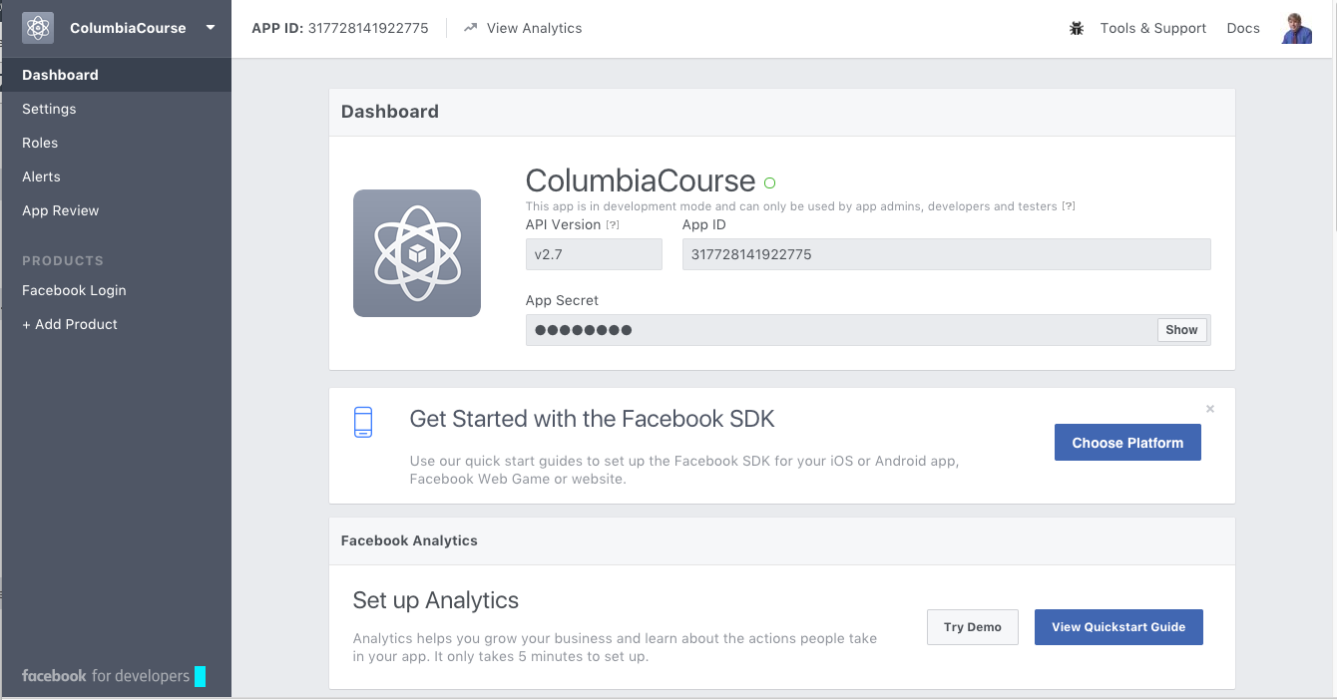
Define Application

Slide 24
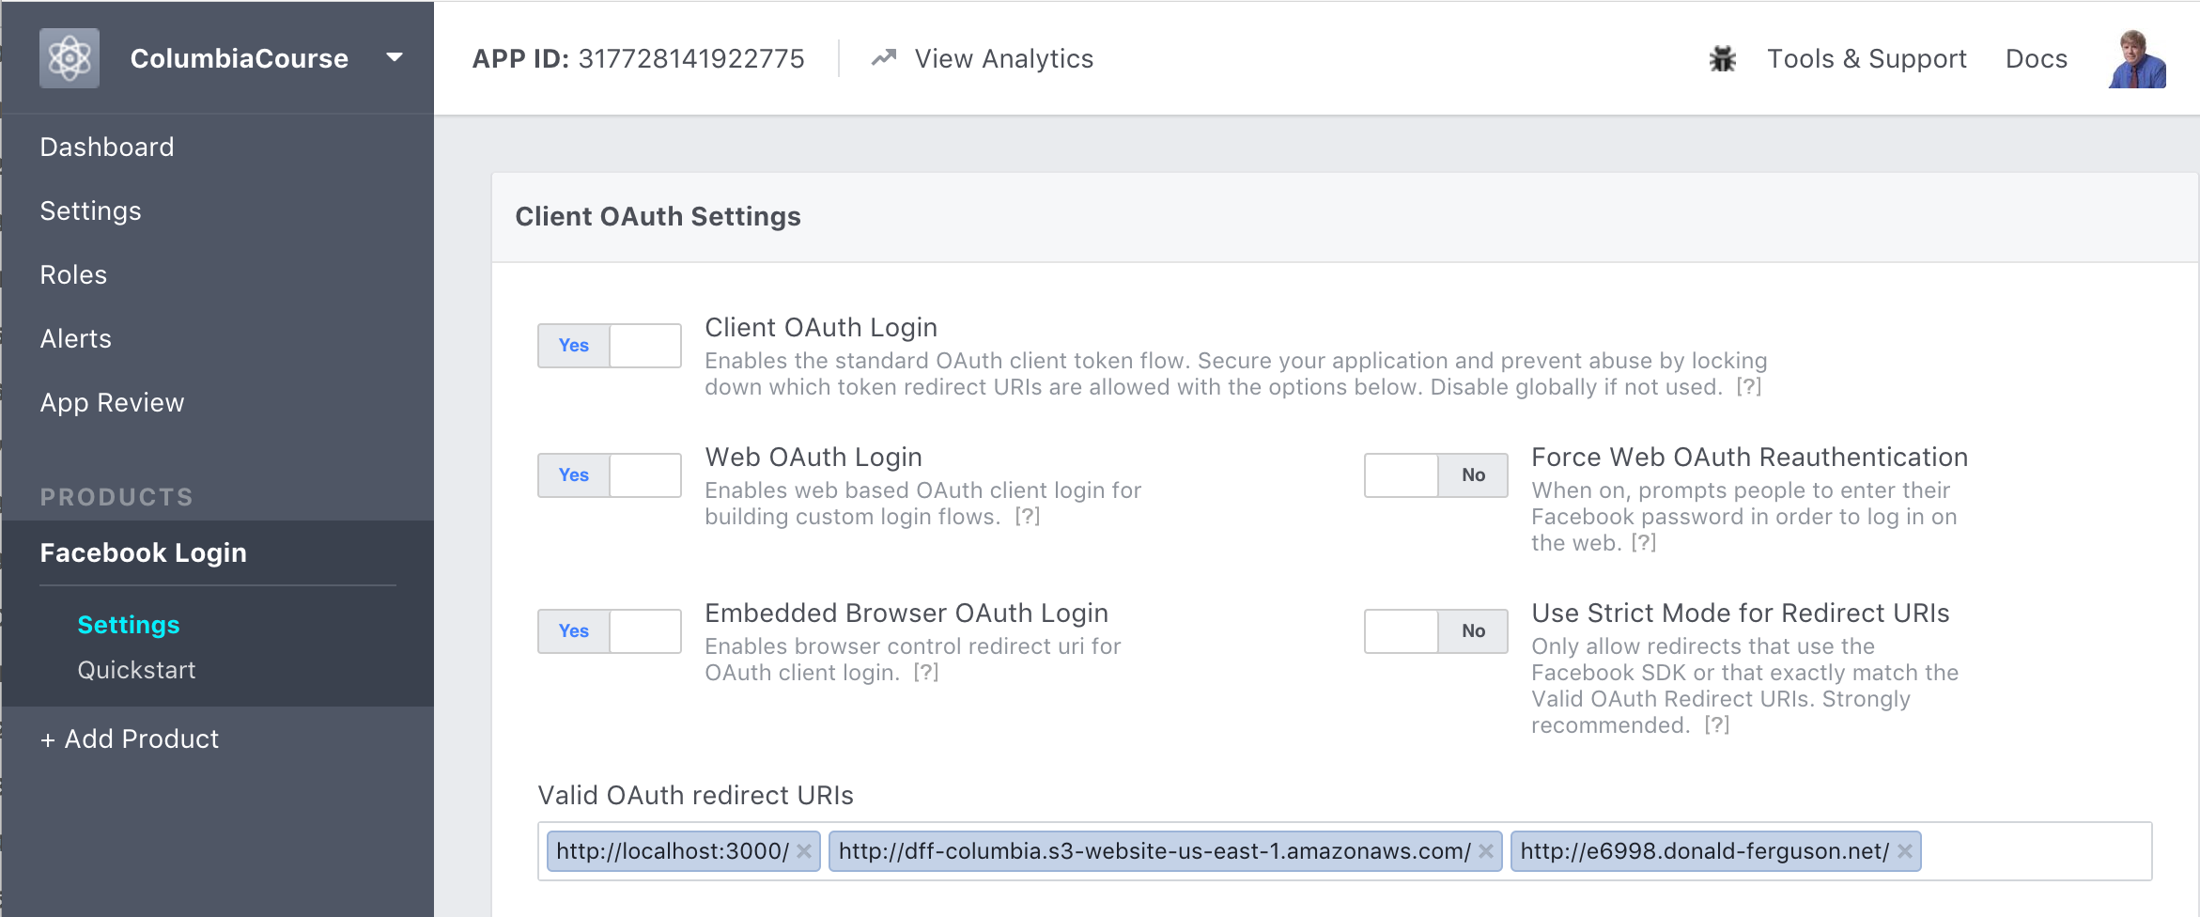
Define Application

Slide 25
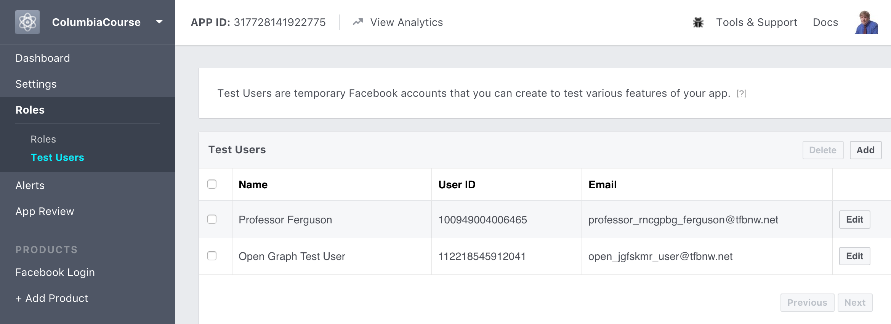
Define Application

Slide 26
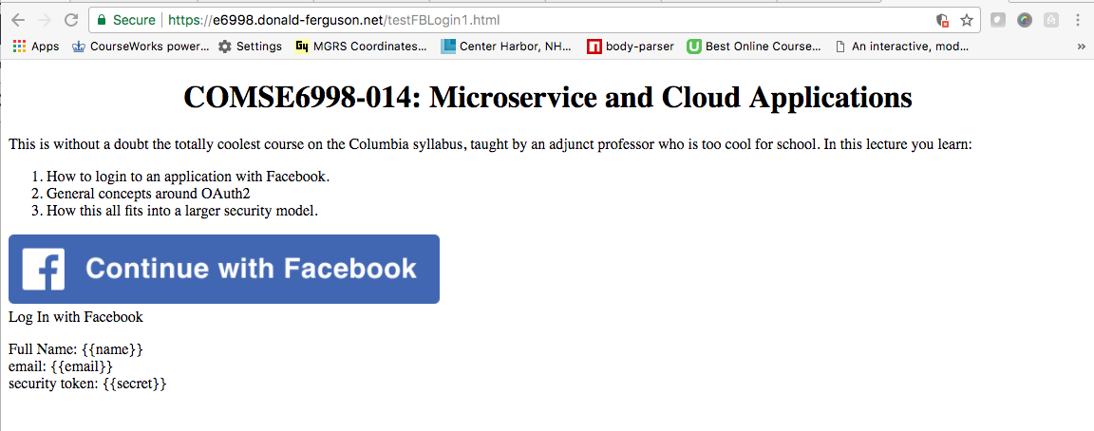
Web Page

Slide 27
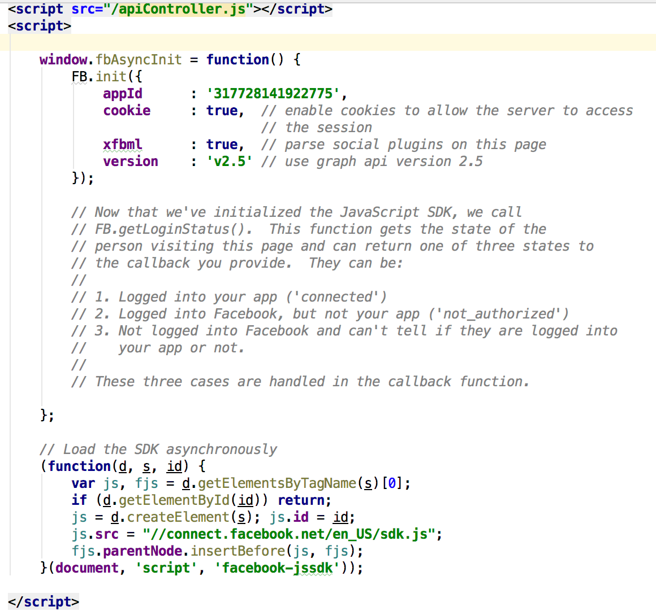
Code (I)

Slide 28
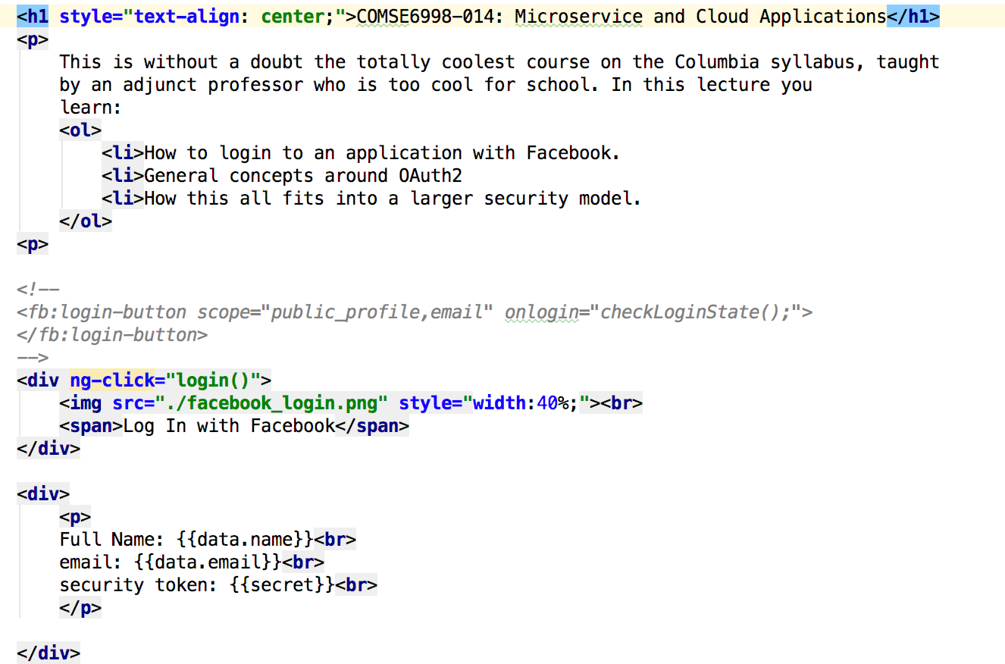
Code (II) HTML

Slide 29
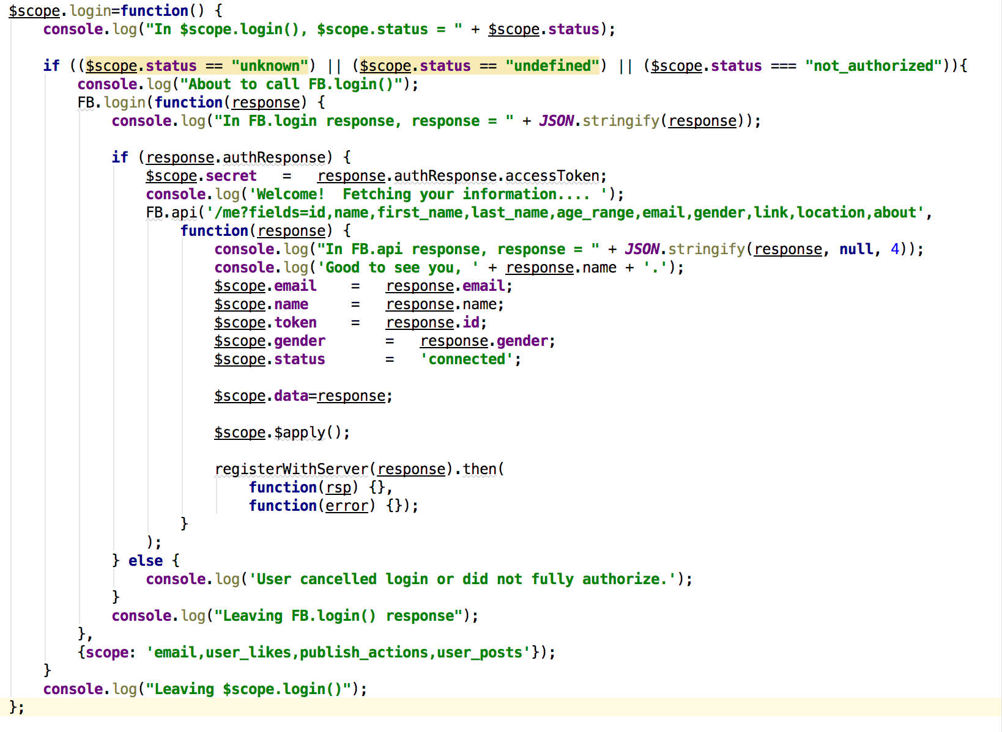
Code (III) Controller
Do not worry about this if test. The code does not do anything and is there because I copied the code.

Slide 30
Code (III) Controller
Your login/registration server call goes here.
In a “services” module.

Slide 31
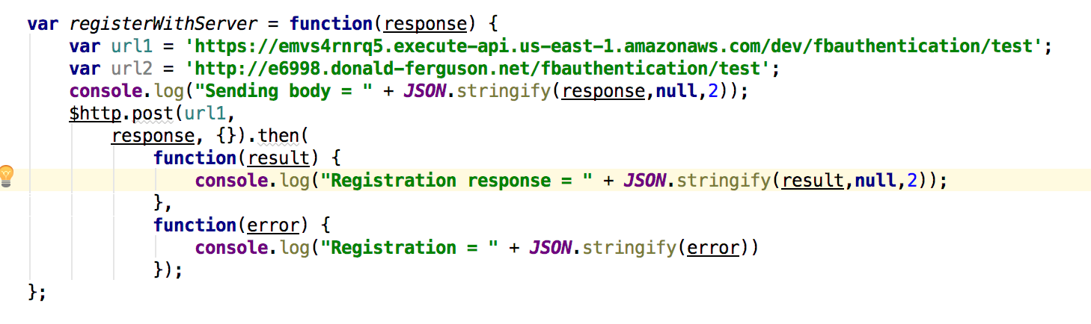
Sending Registration Request
I had some trouble with the CloudFront → API Gateway. Using direct GW URL for now.
Also a little wonkiness around HTTP/HHTPS
Had poor Internet connectivity this weekend and will figure out this week.

Slide 32
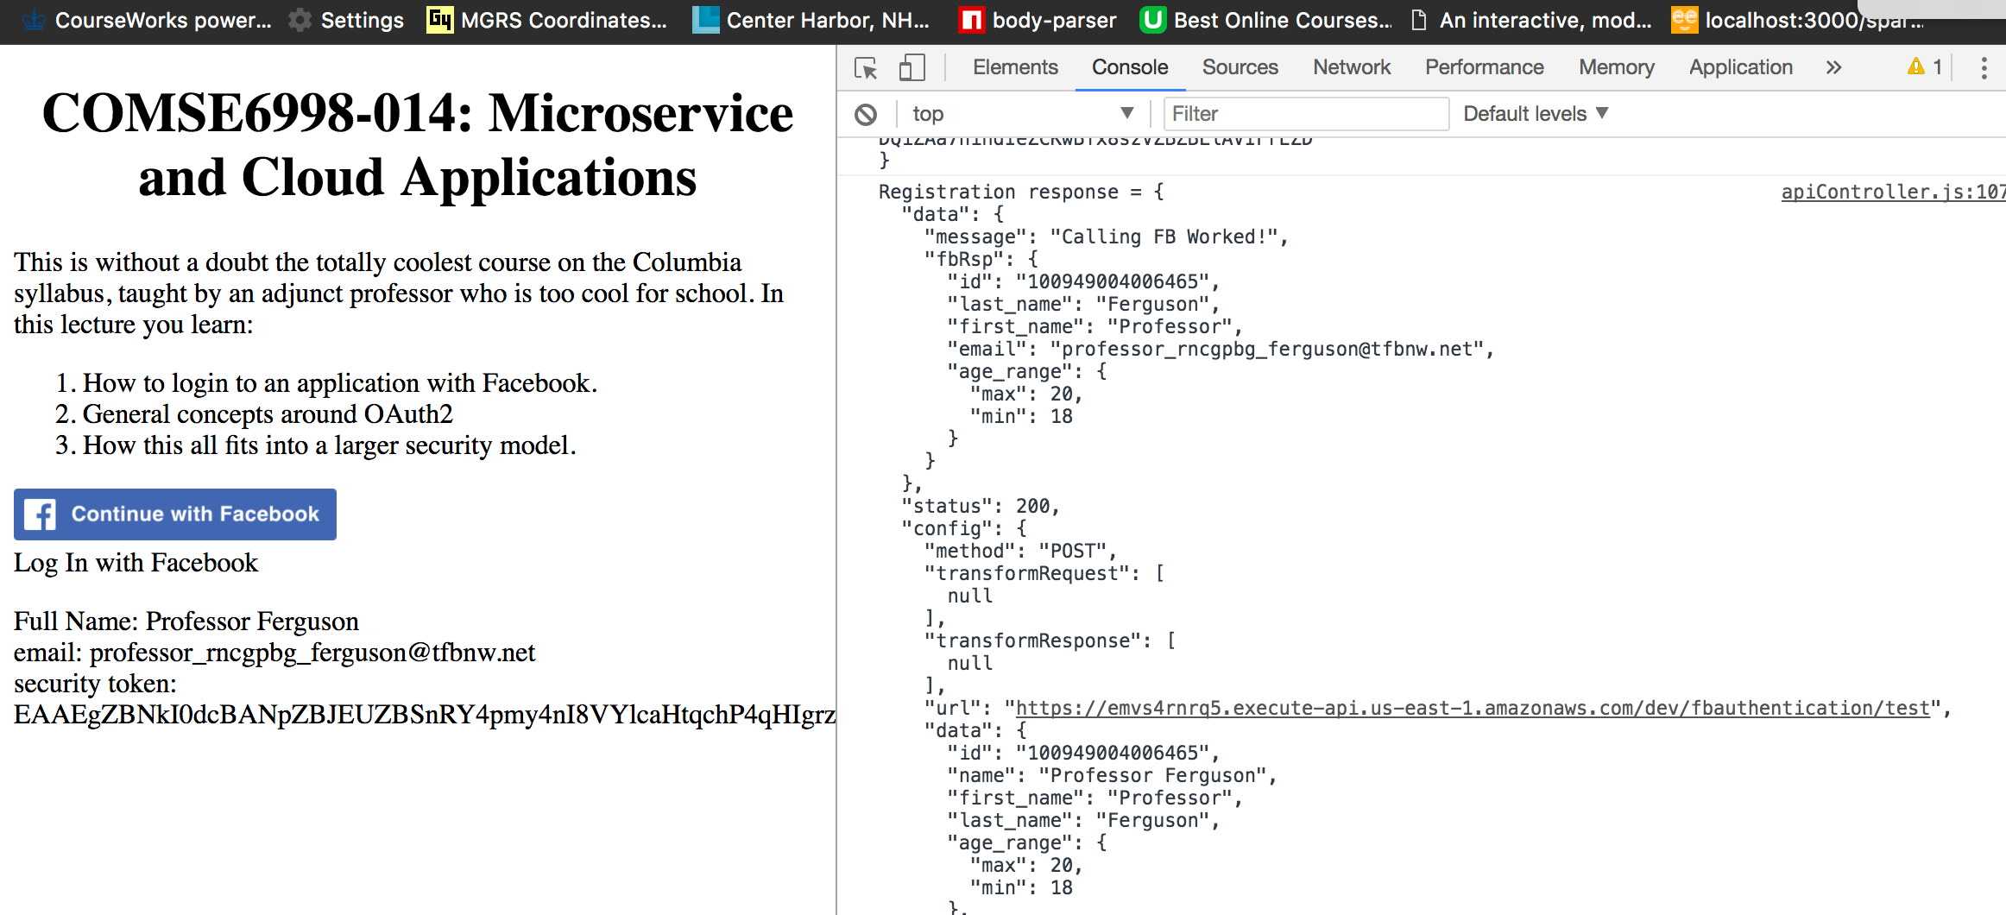
Facebook Login

Slide 33
Backend

Slide 34
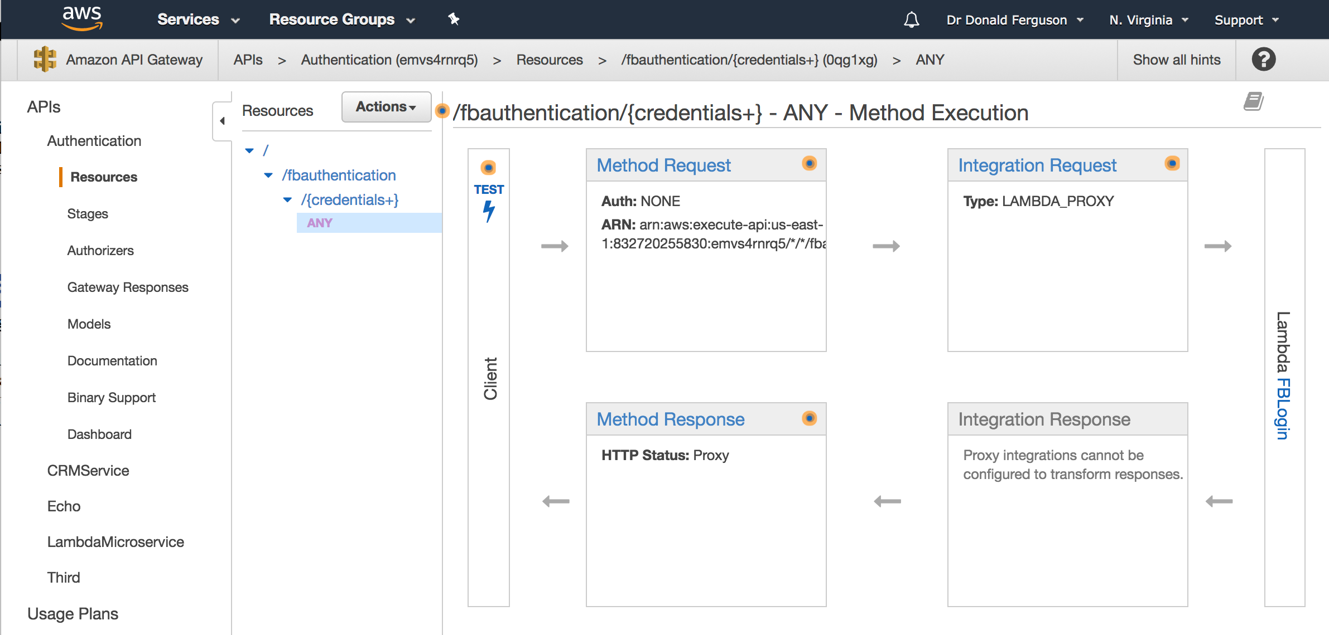
API Gateway

Slide 35
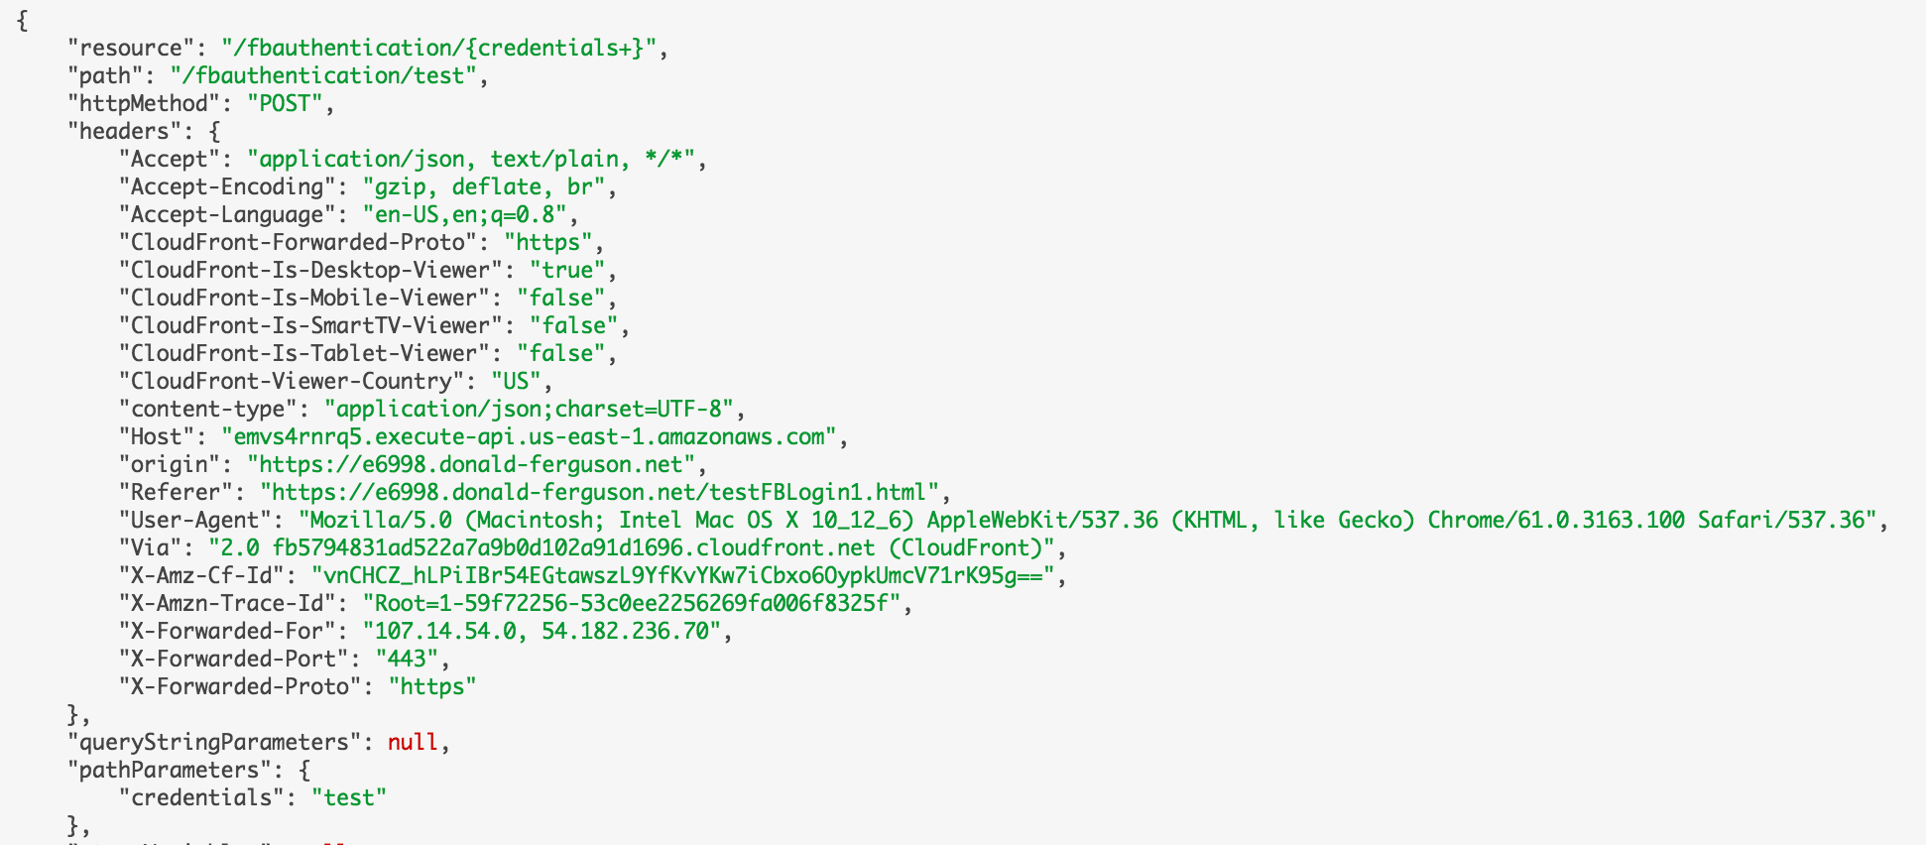
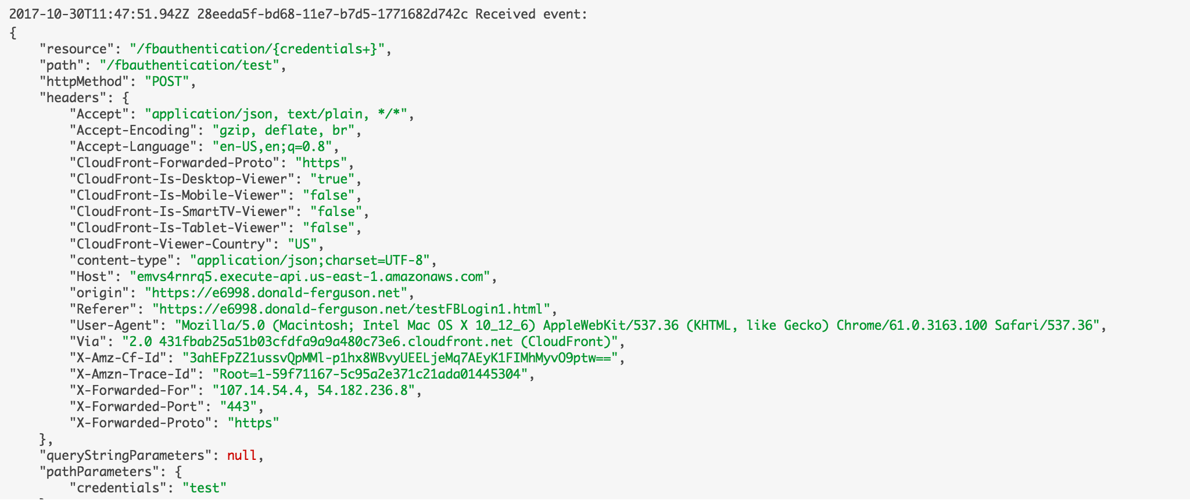
Lambda Input (I)

Slide 36
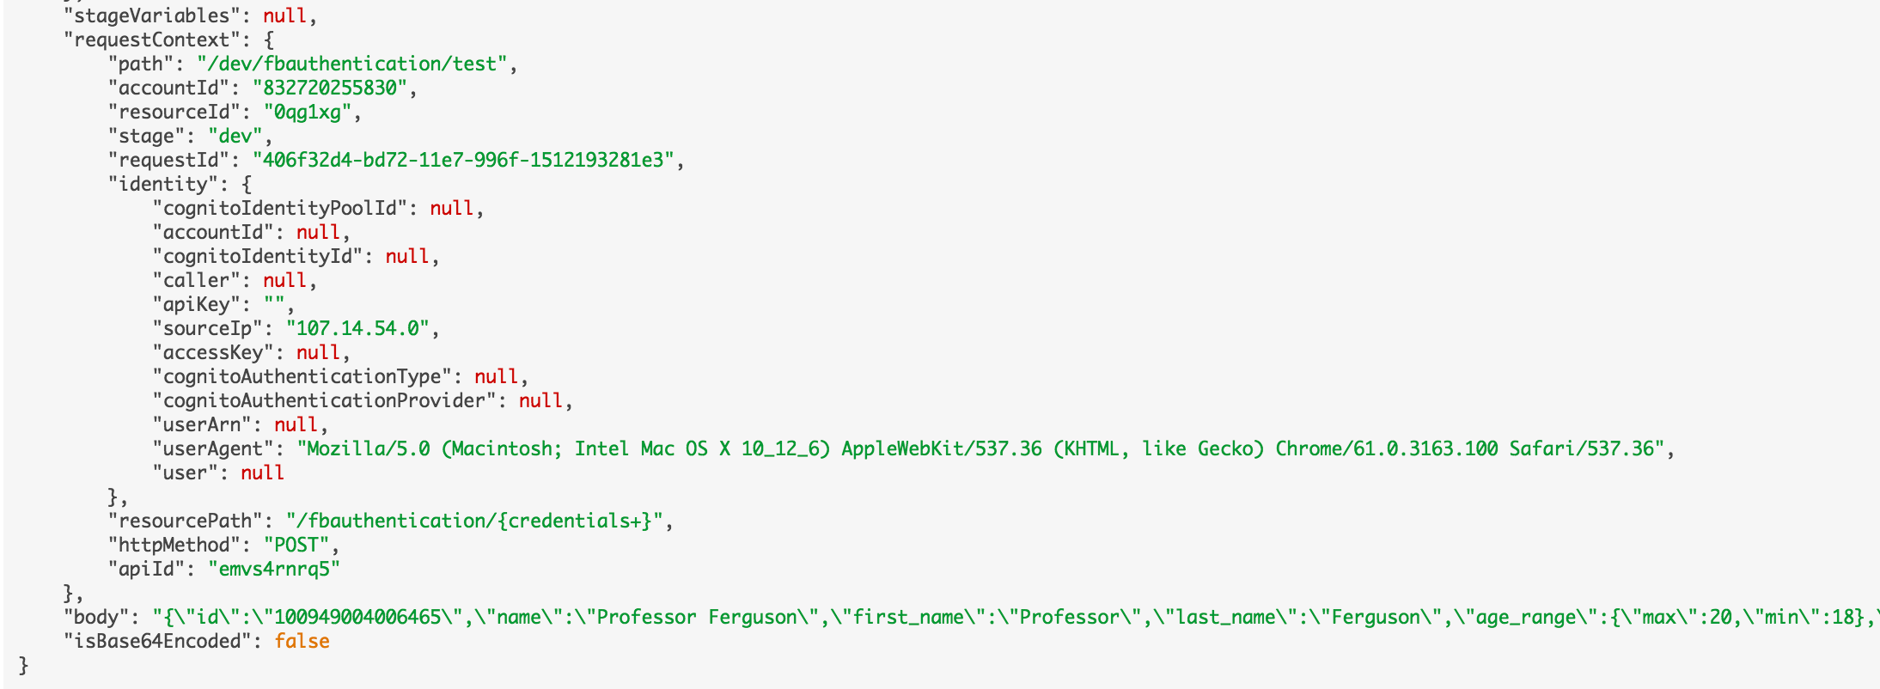
Lambda Input (II)

Slide 37
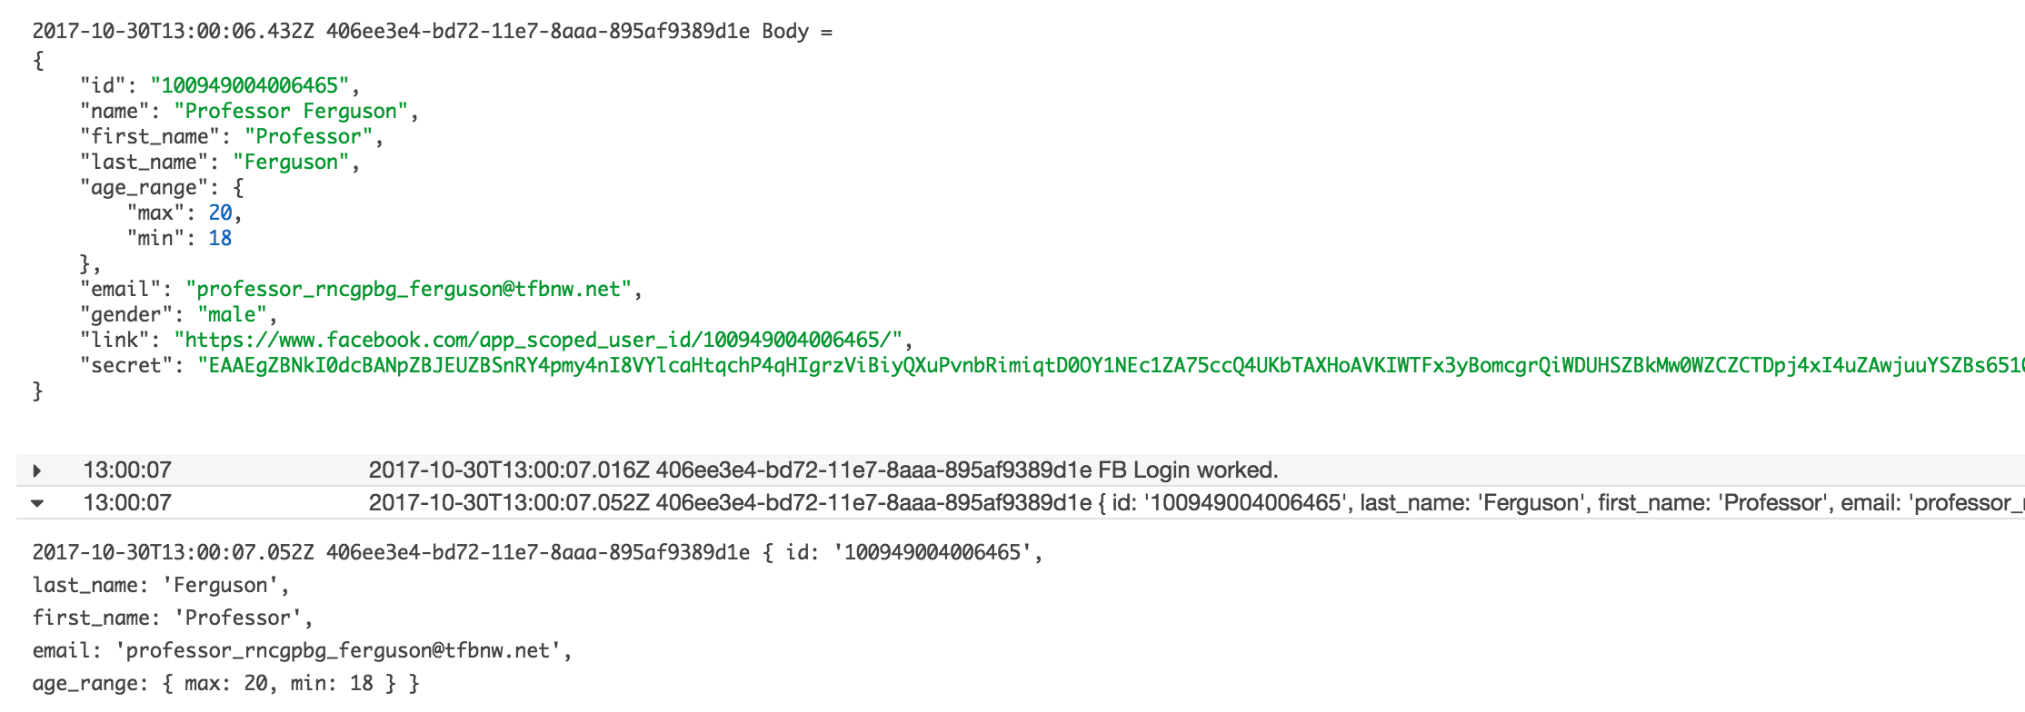
Lambda Input (III)

Slide 38
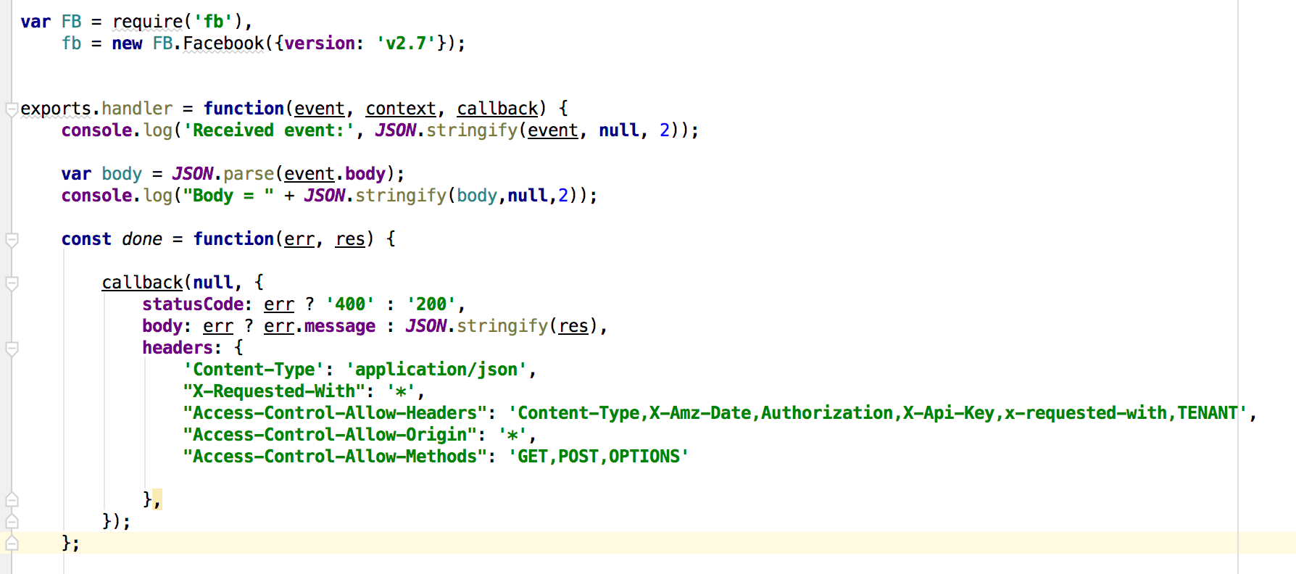
Lambda Function (I)

Slide 39
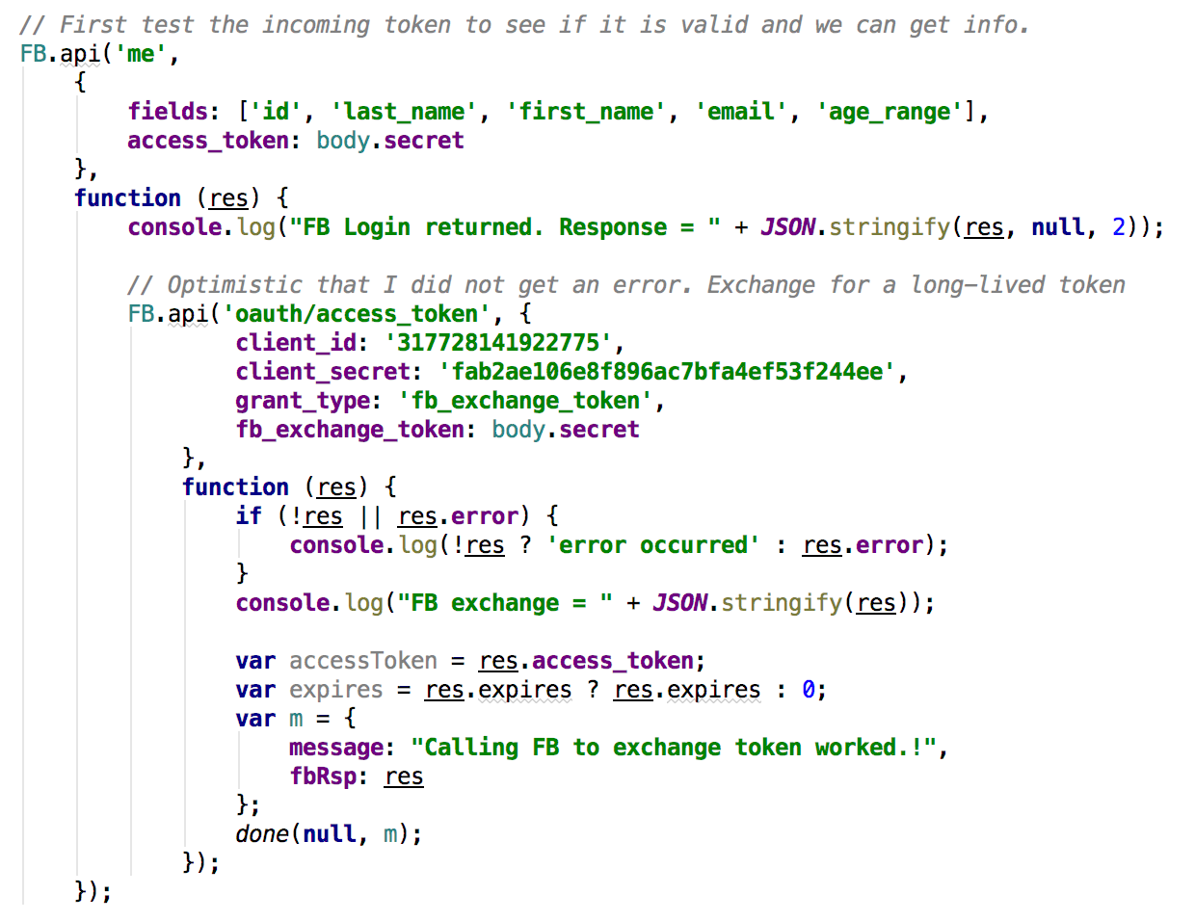
Lambda Function (II)
Call FB API and get basic info, which also validates token.
Call FB to covert
60 minute token
Into long lived token
Save token and profile info in user DB (TBD)

Slide 40
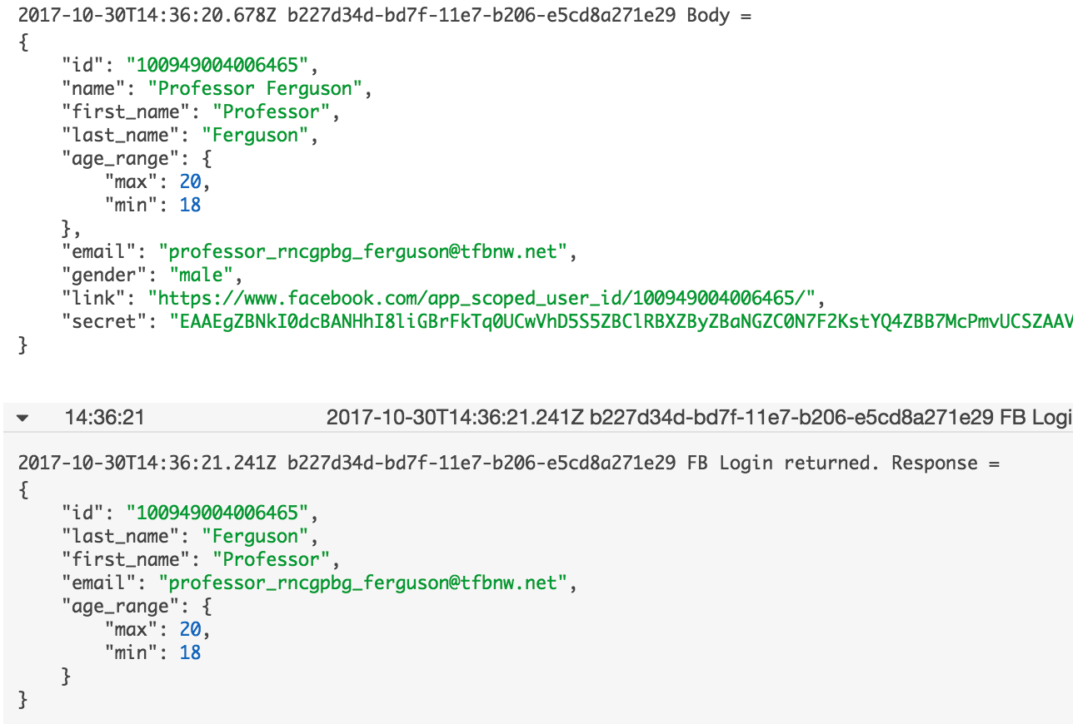
Execution Console Messages (I)

Slide 41
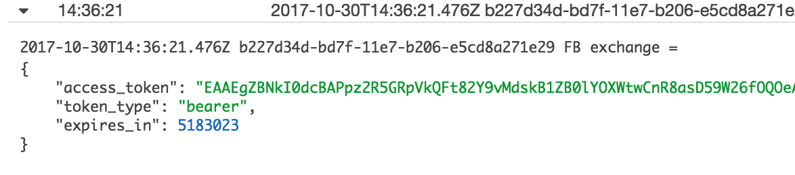
Execution Console Messages (II)
Initial token is valid for 60 minutes.
Long lived token above is good for 5183023/3600/60 = 60 days.
Eliminates annoying re-login, even if customer already logged on.
Server can refresh token as long as user has not removed application.

Slide 42
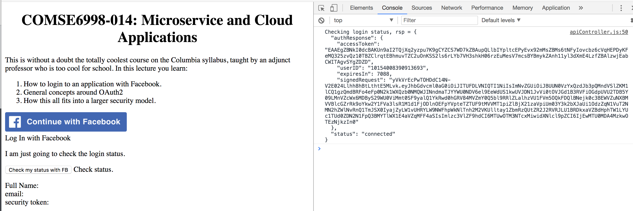
A Slight Modification
Before showing login button, you can check the status wrt your application
connected: User is logged onto Facebook and has previously authorized app.
not_authorized: User is logged on but has not authorized application.
unknown: User not logged on.
Only show login button and drive dialog in cases (2) and (3).

Slide 43
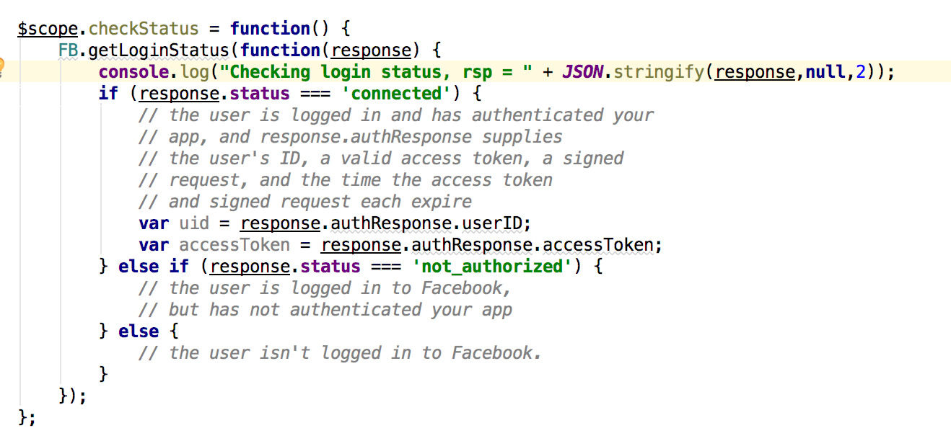
Controller Code
I just use the button to show triggering call.
Can check login status silently on page load.

Slide 44
Social Media Registration (OAuth2 – full) (Twitter)

Slide 45
Overview (http://tutorials.jenkov.com/oauth2/index.html)
Resource Owner
Controls access to the “data.”
Facebook user, LinkedIn user, …
Resource Server
The website that holds/manages info.
Facebook, LinkedIn, ...
And provides access API.
Client Application
“The product you implemented.”
Wants to read/update
“On your behalf”
The data the data that the Resource Server maintains, e.g. posts, status, tweets, ...
Authorization Server
Grants/rejects authorization
Based on Resource Owner decisions.
Usually (logically) the same as Resource Server.

Slide 46
Roles/Flows
User Clicks “Logon with XXX”
Redirect user to XXX
With Client App application ID.
And permissions app requests.
Code MAY have to call Resource Server to get a token to include in redirect URL.
Browser redirected to XXX
Logon on to XXX prompt.
Followed by “do you grant permission to …”
Clicking button drives a redirect back to Client App. URL contains a temporary token.
User/Browser
Redirected to Client App URL with token.
Client App calls XXX API
Obtains access token.
Returns to User.
Client App can use access token on API calls.

Slide 47
Twitter Example

Slide 48
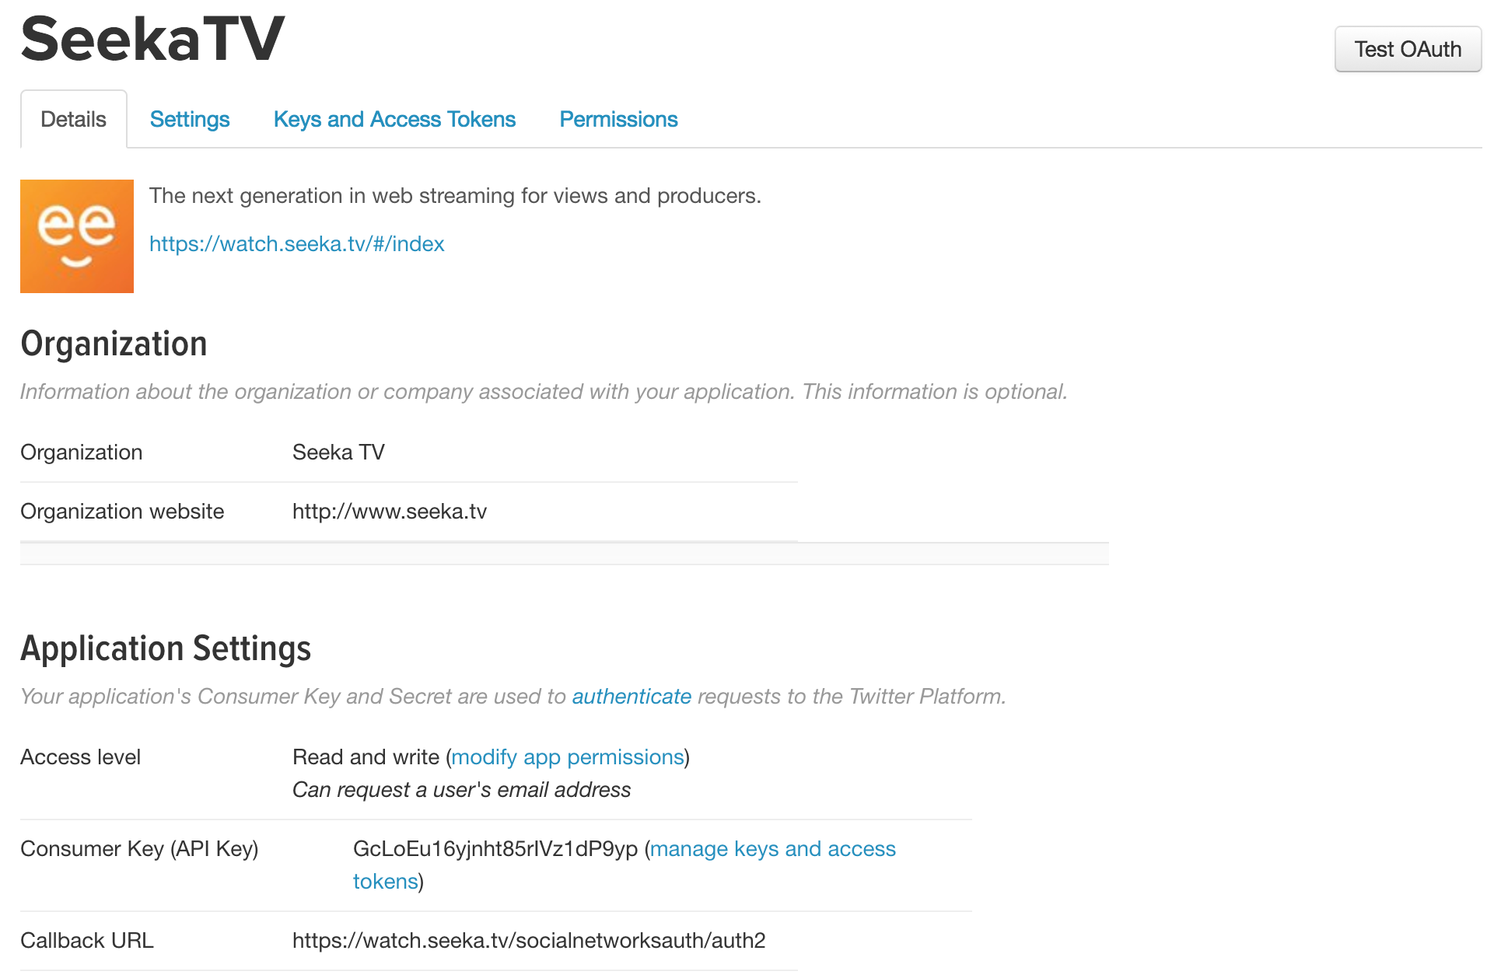
Twitter Application Configuration
URL for second redirect.

Slide 49
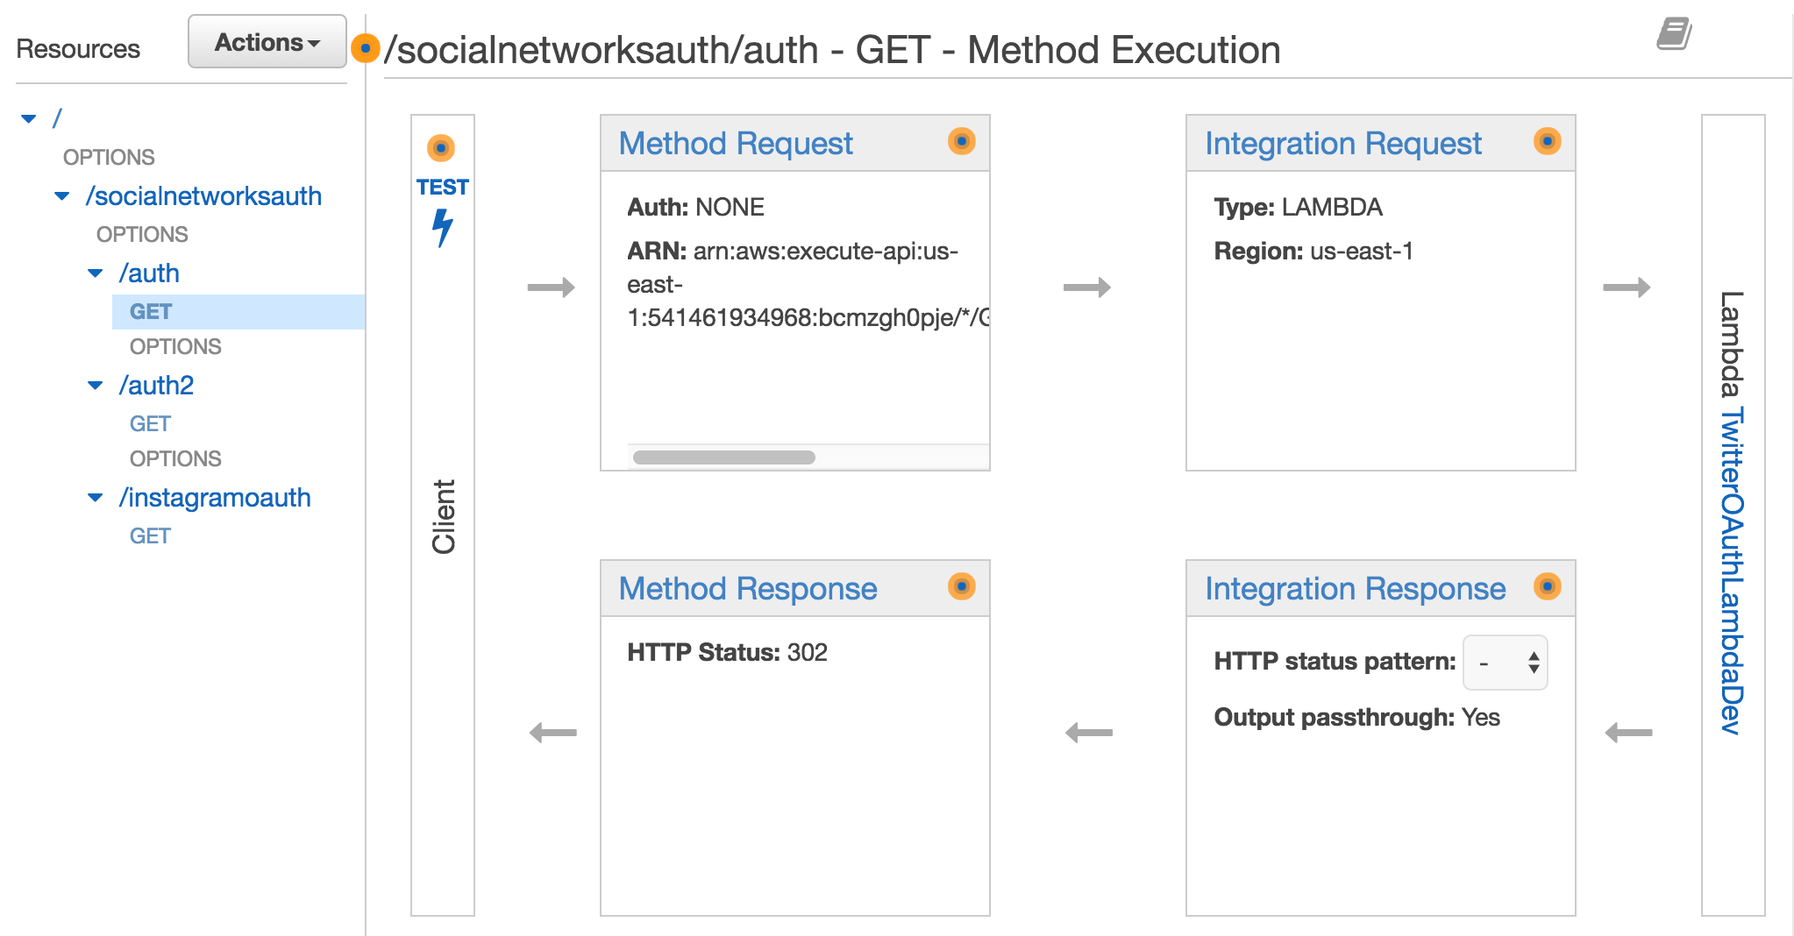
Twitter OAuth2 – Phase 1
ng-glick goes to this URL. $window.location=…

Slide 50
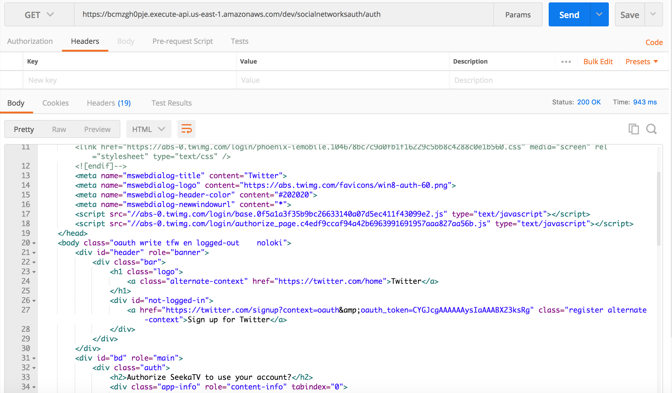
Calling API on Click
Redirected
To
Twitter Logon
Page

Slide 51
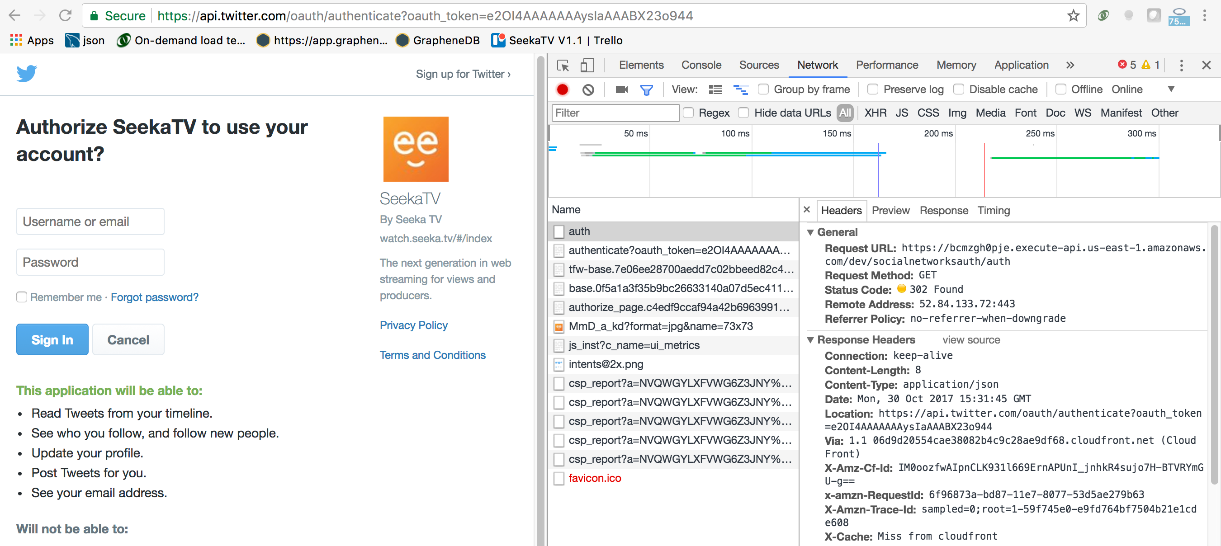
A Little More Detail
Successful login to Twitter
Drives a redirect to registered URL https://www.seeka.tv/socialnetworkauth/auth2 (2nd step in Lambda function)
Original GET
Redirect to twitter with app token

Slide 52
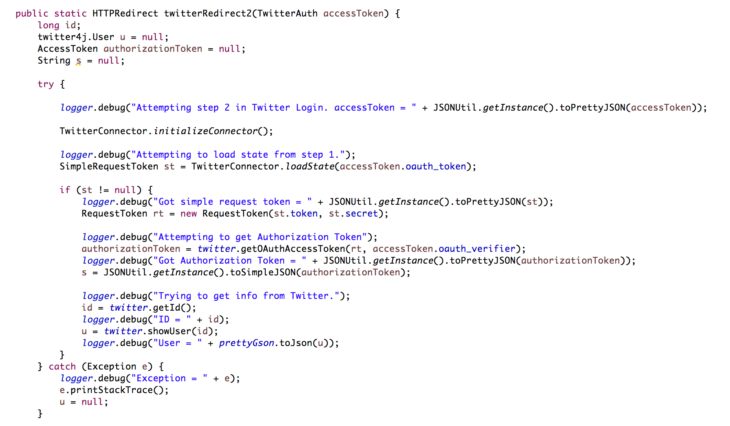
2nd Step in Lambda (I)
Correlate with previous step to handle multiple user logins.
Call Twitter to convert to long life, final bearer token.

Slide 53
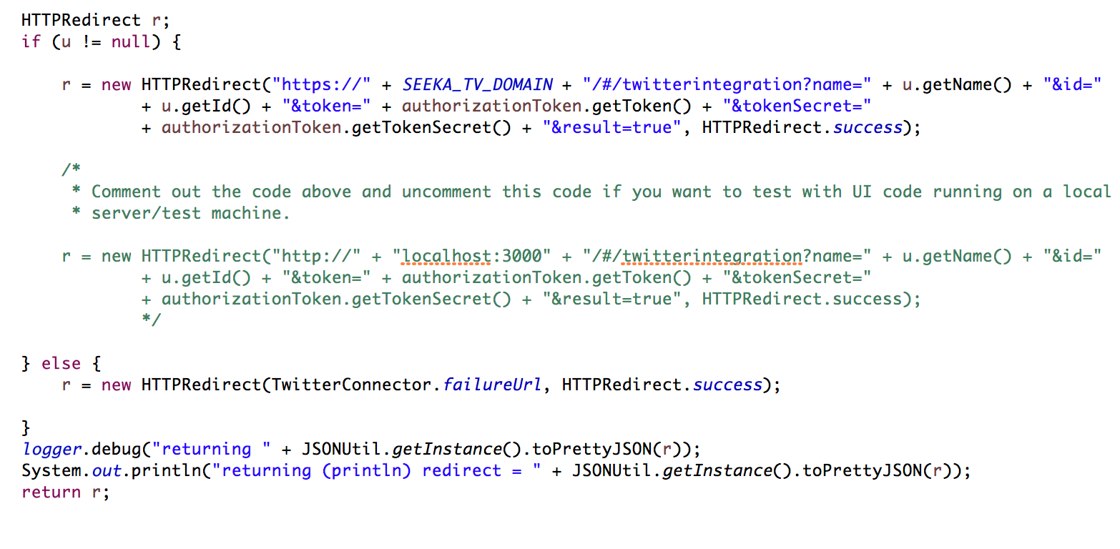
2nd Step in Lambda (I)
Generate redirect with user ID and info → Your apps’ UI page.

Slide 54
Authorization

Slide 55
Division of Responsibility

Slide 56
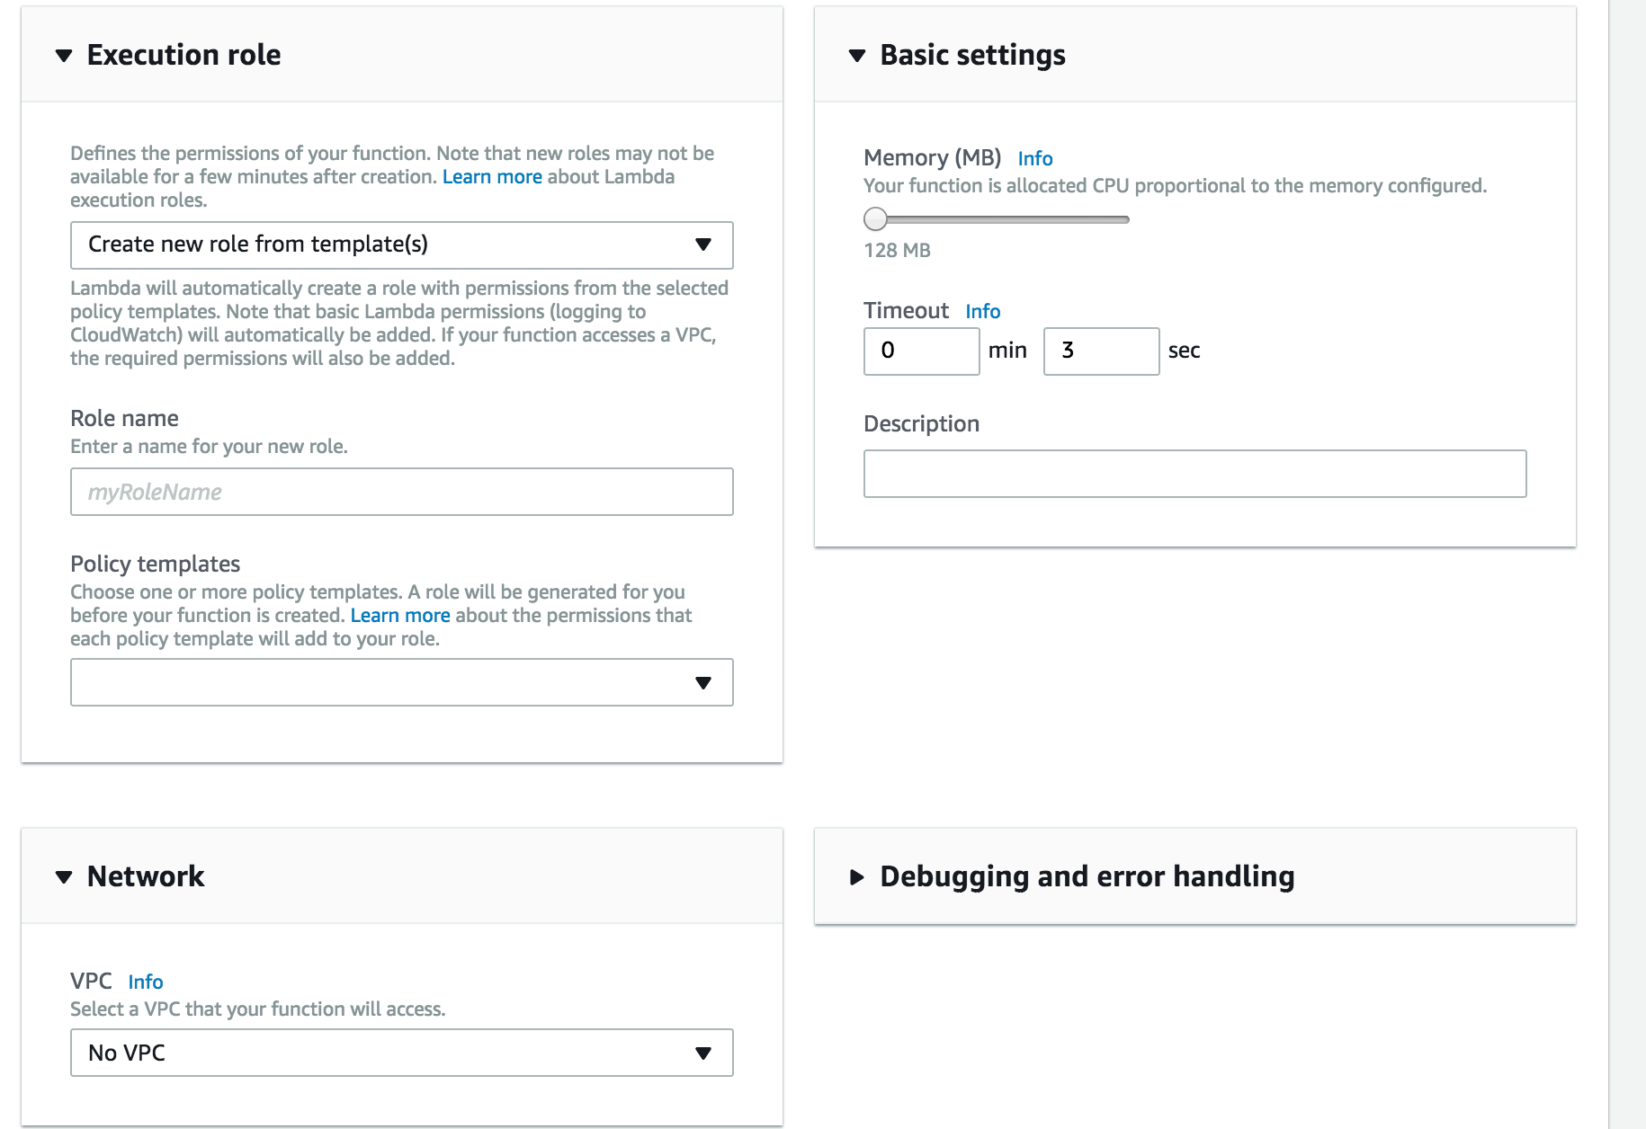
Division of Responsibility
Resources
DynamoBD tables.
S3 buckets.
SNS topics.
etc.
Have unique ARNs.
Your elements
That “do something,” e.g.
EC2 instance.
BeanStalk app.
Lambda functions.
Execute in a role (ID)
Have associated policies that specify allowed
Operations
On resources

Slide 57
Division of Responsibility

Slide 58
Division of Responsibility
The application and supporting middleware and libraries are responsible for authorization of application-level resources, e.g.
Specific database tables or tuples.
Specific DynamoDB tables or documents.
Performing specific operations on URLs.
Same basic model
Application defined “resource names,” e.g.
/customers/accounts/21
/customers/*
Authenticated users maps to named roles with associated policies, e.g.
{“Agent”, “/crm/agents/21/accounts/*”, {POST, DELETE, GET, PUT}}
{“Customer”, ”/commerce/customer/carts/*”, {POST, DELETE, GET, PUT}}
Authorization checks
Explicit calls in application code, or
Handler/interceptor middleware similar to ETag and Idempotency checks.
Security admin application that allows
Defining application resource templates and operations.
Creating and associating policies and roles.
Table for mapping IDs to roles and policies.

Slide 59
Authorization
Security Microsevice
CRUD resources ID, roles, policies
Central API for checking operation authorization from code.
Previous
Login Flow

Slide 60
Authorization
User logon to service/environment
Via email, Facebook, Twitter
Generates and returns a JWT token with identity, role and policy information.
Which flows in a customer header on also subsequent requests.
API Gateway
Calls Custom Authorizer with headers, URL, body, query params.
Custom authorizer calls authorization microservice (2nd Lambda)
Which returns decision → Customer Authorizer → API Gateway.
Other environments, e.g. Lambdas, BeanStalk
Also call authorization microservice
Passing resource, user info, operation
To determine if authorization allowed.
2nd part of project 4 will be fleshing out authorization to support 1st part of project 4, which is authentication/registration via social media.

Slide 61
Backup

Slide 62
Authorization
1st check occurs at perimeter in API GW Authorization
Based on (bearer token) JWT token
Is this role authorized to invoke this URL?
Implementation
Lambda function that …
Checks an authorization table (role, URL)
Or the rights are encoded in the token.
All down stream microservices
Receive the JWT token and perform their own authorization decisions.
Run with a set of AWS roles and permissions that determine if AWS allows access, which may include user role.

Slide 63
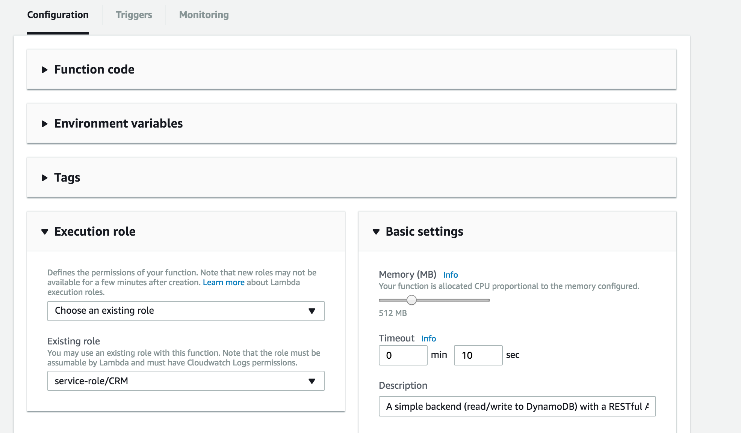
An Example – Lambda Function Role

Slide 64
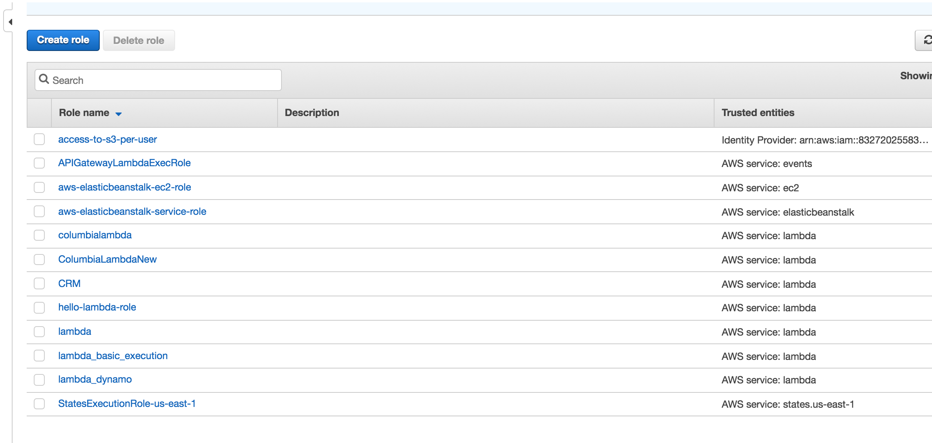
Role/Policies

Slide 65
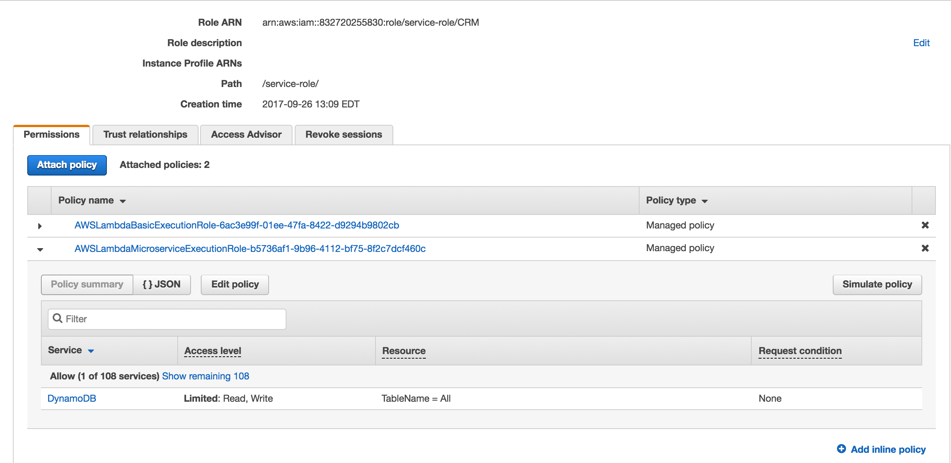
Role/Policy

